Slide 1
WEB3, Session 8
Functional Programming Patterns

Slide 2
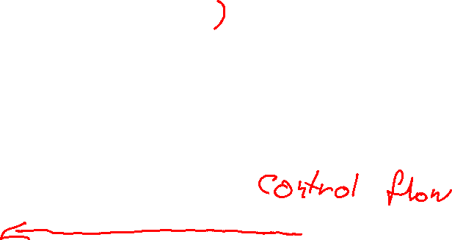
Problem 1: Control Flow
const dragons = (pets: Pet[]) =>
pets.filter(p => p.type === 'dragon'
const ages = (pets: Pet[]) =>
pets.map(p => p.age)
const sum = (ns: number[]) =>
ns.reduce((sum, n) => sum + n, 0)
let sumOfAgeOfDragons = sum(ages(dragons(pets)))

Slide 3
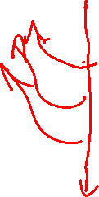
Problem 1: Control Flow - early return
export function player_in_turn(games: Game[], id: number) {
const game = games.find(g => g.id === id)
if (game === undefined) return undefined
if (game.pending) return undefined
if (game.player_in_turn === undefined) return undefined
return game.players[game.player_in_turn]
}

Slide 4
Problem 1: Control Flow - callback hell (I)
function games_waiting_for_player(player, callback) {
const xhr = new XMLHttpRequest()
xhr.open('GET', 'http:/localhost:8080/active')
xhr.onload = _ => {
const games = JSON.parse(xhr.responseText)
const active_games = games
.filter(g => g.player_in_turn !== undefined)
const waiting_games = active_games
.filter(g => g.players[g.player_in_turn] === player)

Slide 5
Problem 1: Control Flow - callback hell (II)
const loaded_games = []
for(let game of waiting_games) {
const gameXhr = new XMLHttpRequest()
gameXhr.open('GET', `http://localhost:8000/active/${game.id}`)
gameXhr.onload = _ => {
loaded_games.push(JSON.parse(gameXhr.responseText))
if (loaded_games.length === waiting_games.length)
callback(loaded_games)
}
gameXhr.send()
}
}
xhr.send()

Slide 6
Problem 2: Proliferation of anonymous functions
const sumOfAgeOfDragons = pets
.filter(p => p.type === 'dragon')
.map(p => p.age)
.reduce((acc, age) => acc + age, 0)

Slide 7
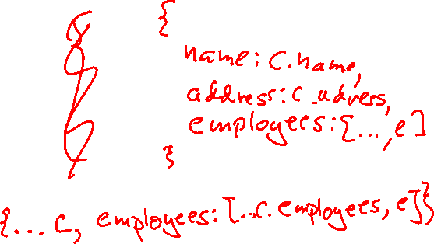
Problem 3: Updating data
const hireEmployee =
(e: Person, c: Company) =>
createCompany(
c.name,
c.address,
[...c.employees, e])

Slide 8
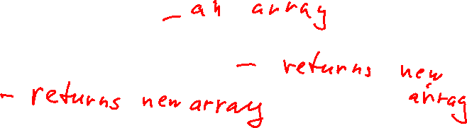
Problem 4: Excessive array creation
const sumOfAgeOfDragons = pets
.filter(p => p.type === 'dragon')
.map(p => p.age)
.reduce((acc, age) => acc + age, 0)

Slide 9
Solutions
(1) Monads and/or functional composition
(2) Currying
(3) Persistent data structures
Allow changes with minimal copying
(4) Lazy sequences/Flyweight
Intermediate object delays construction of array until necessary

Slide 10
Functors and Monads
Functors and monads are data structures/objects that are designed for pipelines
They are types that wrap around another "element" type
like Array<string>
The point of the functors and monads is that you can apply functions on the "elements"
The result with be the same type of functor or monad, but with the value updated

Slide 11
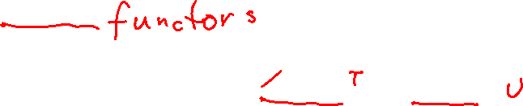
Functors
Has a function/method that allows application of simple functions to the data inside
The function/method is usually called map
Assume we have a functor, F<T>
The functions we can apply would have type (t: T) => U
The result of mapping the functor would have type F<U>
Arrays are monads
const a: Array<string> = ['here', 'we', 'go']
s => s.length has type (s: string) => number
a.map(s => s.length) is an Array<number>

Slide 12
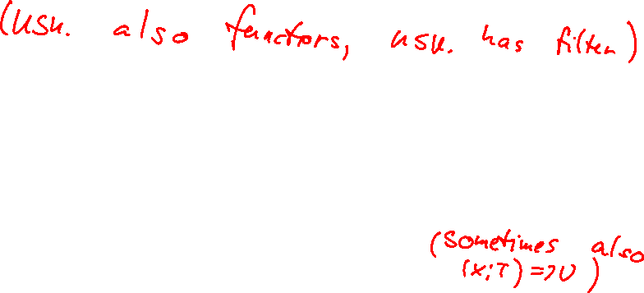
Monads
Monads: Has a function/method that allows for deconstruction, application of a function, then reconstruction of the data structure
The function/method is usually call flatMap (formally "bind")
Assume we have a monad, M<T>
The functions we can apply have type (x: T) => M<U>
The result of mapping the monad will have type M<U>
Arrays are monads because of the flatMap method
const a: Array<string> = ['modern', 'condition', 'fix']
s => ['pre'+s, 'post'+s] has type (s: string) => Array<string>
a.flatMap(s => ['pre'+s, 'post'+s]) has type Array<string>

Slide 13
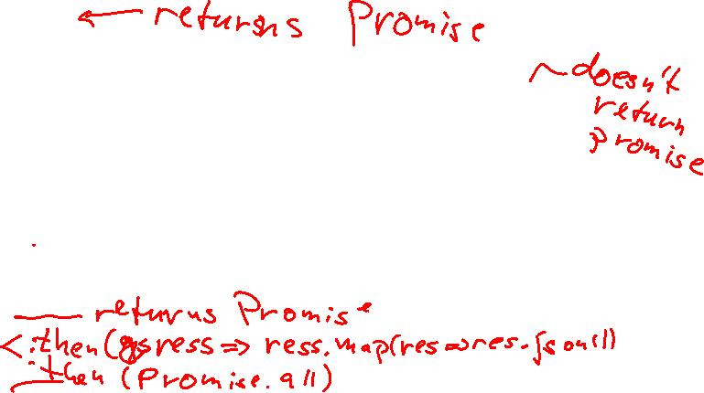
The Promise Monad
fetch('http:/localhost:8080/active')
.then(res => res.json())
.then(games =>
games.filter(g => g.player_in_turn !== undefined))
.then(active_games =>
active_games.filter(g =>
g.players[g.player_in_turn] === player))
.then(waiting_games =>
waiting_games.map(g =>
fetch(`http://localhost:8000/active/${g.id}`)))
.then(Promise.all)
.then(callback)

Slide 14
The Optional Monad
Also known as Option or Maybe
Alternative to T | undefined (or T | null)
Optional<T>: The element is there, or it isn't
Similar to an array with at most 1 element

Slide 15

Optional interface
export interface Optional<T> {
isPresent(): boolean
ifPresent(consumer: (element: T) => void): void
map<U>(f: (element: T) => U): Optional<U>
flatMap<U>(f: (element: T) => U | Optional<U>): Optional<U>
filter(predicate: (element: T) => boolean): Optional<T>
get(): T
getOrElse(fallback: T): T
or(other: Optional<T>): Optional<T>
}

Slide 16
Optional implementation
There are no "standard" optional libraries
Might be because TypeScript offers enough protection against nullish
Implemented it myself
See
"08 Functional Patterns/patterns/optional.ts"
"08 Functional Patterns/patterns/with_optional.ts"

Slide 17

Either Monad
When a function can return to very different things
Alternative to T | U
Often used to return errors from a function: Either<Error | Response>
In that case it is often called a Try or a Result monad.
See "yahtzee functional/server/src/response.ts"

Slide 18

lodash
import * as _ from 'lodash'
Many extra utility functions
Mostly for functional programming, but some functions mutate their input
lodash/fp is purely functional
import * as _ from 'lodash/fp'
We'll mostly look at lodash/fp

Slide 19
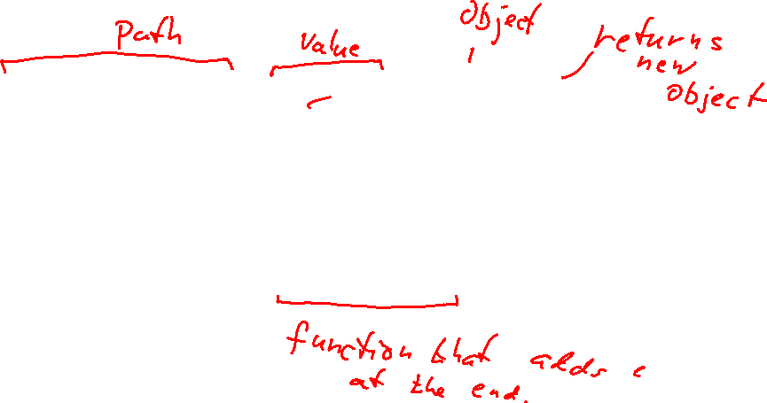
"Modifying" (lodash/fp)
_.set
_.set(['scores', key], score(…), section)
Corresponds to section.scores[key] = score(…)
Instead of _.set we can apply a function: _.update
const addEmployee = (e: Person, c: Company) => _.update('employees', _.extend(e), c)

Slide 20
Currying
A curried function is a function that takes several parameters "one at a time"
It gets one parameter and returns a new function
That function gets another parameter and so on until all parameters are there
The last function returns a value
Used for partial evaluation
In some languages, all functions are curried: F#, Haskell, Elm,…

Slide 21
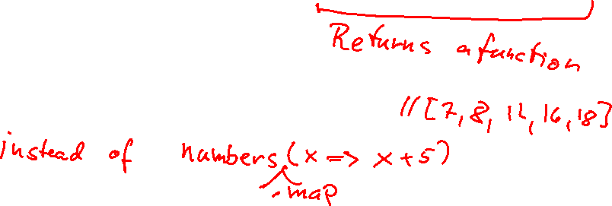
Curried add
const numbers = [2, 3, 7, 11, 13]
const addCurry = (a: number) => (b: number) => a + b
// Good for
console.log(numbers.map(addCurry(5)))
// Bad for
console.log(addCurry(7)(11))

Slide 22
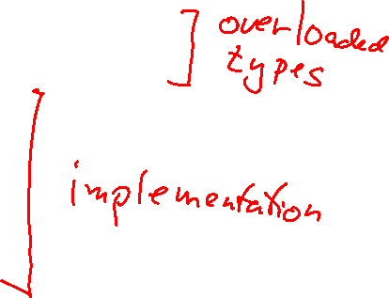
Curried add (2)
function add(a: number): (b: number) => number
function add(a: number, b: number): number
function add(a: number, b?: number) {
if (b !== undefined)
return a + b
return (b: number) => a + b
}
console.log(numbers.map(add(5)))
console.log(add(7, 11))

Slide 23
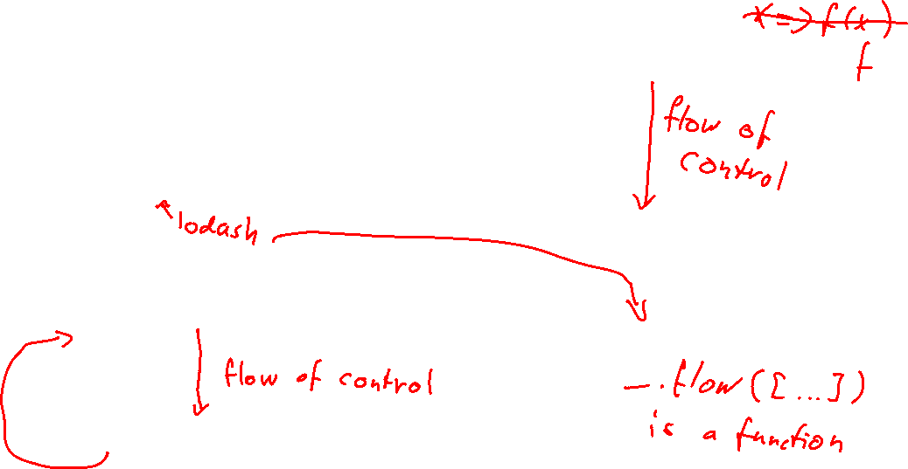
Control flow - variables vs flow
const sumOfAgeOfDragons = (pets: Pet[]) => {
const dragonPets = dragons(pets)
const dragonAges = ages(dragonPets)
return _.sum(dragonAges)
}
const sumOfAgeOfDragons2 = (pets: Pet[]) => _.flow([
dragons,
ages,
_.sum
])(pets)

Slide 24
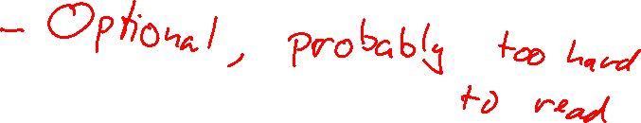
Point-free style
const sumOfAgeOfDragons3 = _.flow([
dragons,
ages,
_.sum
])

Slide 25
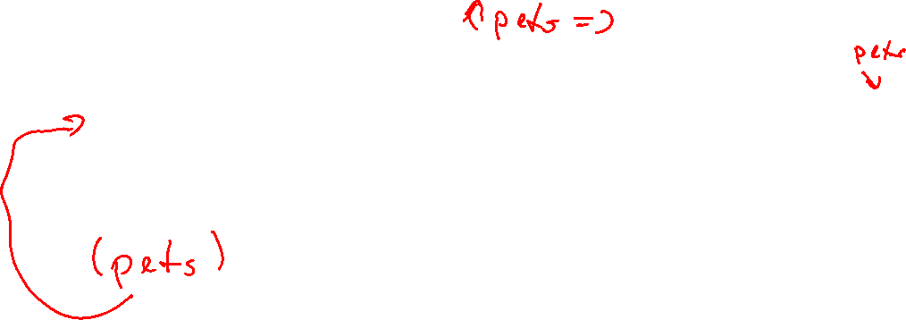
lodash/fp functions are curried
const sumOfAgeOfDragons2 = _.flow([
_.filter((pet: Pet) => pet.type === 'dragon'),
_.map((pet: Pet) => pet.age),
_.sum
])

Slide 26
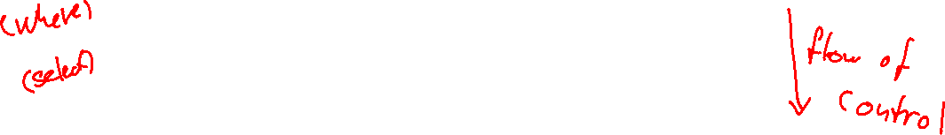
Using curried utility functions
const sumOfAgeOfDragons3 = (pets: Pet[]) => _.flow([
_.filter(_.matches({type: 'dragon'})),
_.map(_.prop('age')),
_.sum
])(pets)

Slide 27
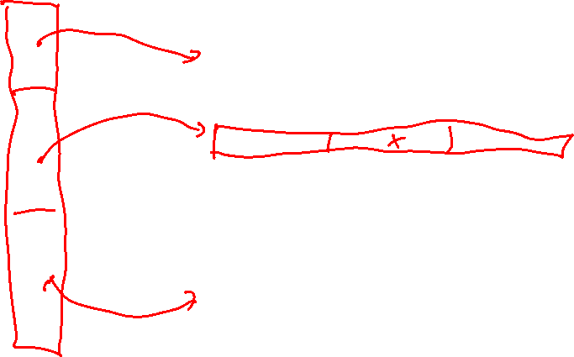
Reducing copying: tic-tac-toe

Slide 28
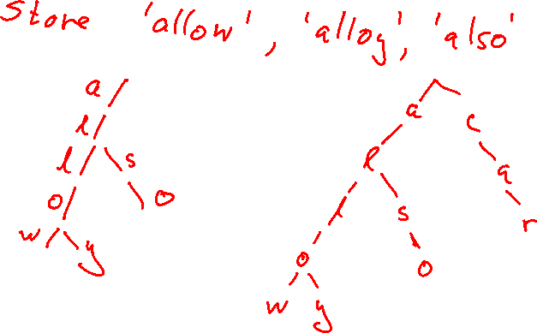
The Trie

Slide 29
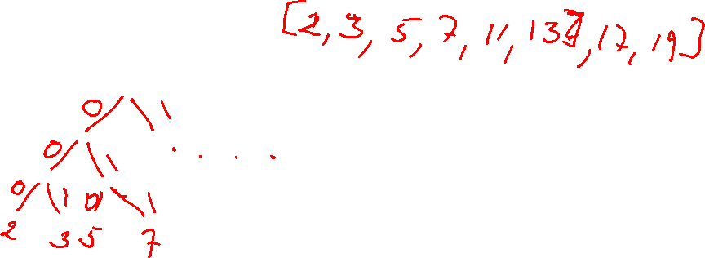
The Binary Trie

Slide 30
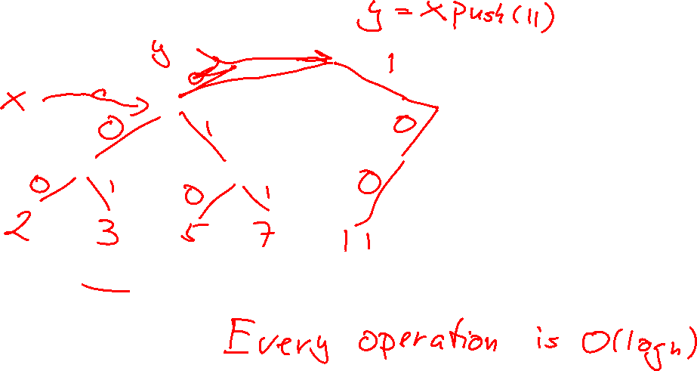
"Adding" an element

Slide 31
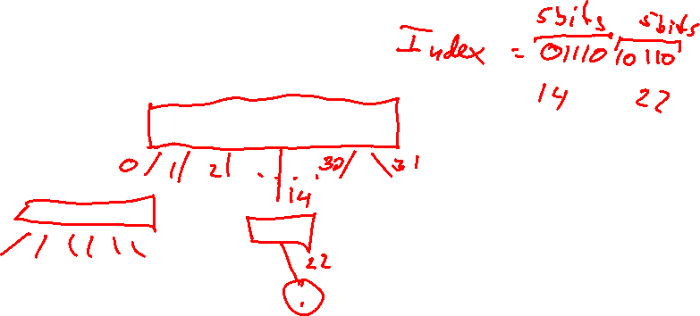
Increasing the fanout

Slide 32

immutable.js
List
Replaces arrays
Map
An associative array
Set
Distinct data
Seq
Lazy sequence
fromJS
A function to turn your data structure immutable
Warning: your objects become Maps

Slide 33
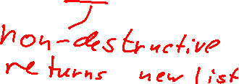
List
Standard TypeScript
With immutable
const hireEmployee =
(e: Person, c: Company) =>
createCompany(
c.name,
c.address,
[...c.employees, e])
addEmployee(employee: Person): Company {
return new Company(
this.name,
this.address,
this.employees.push(employee))
}

Slide 34
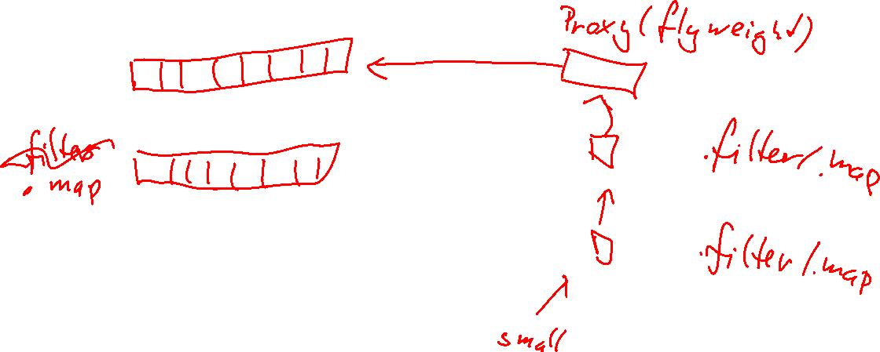
Lightweight proxies

Slide 35
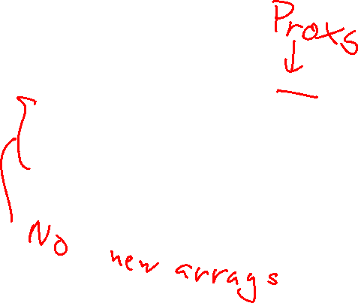
Array creation
Standard TypeScript
With immutable
const sumOfAgeOfDragons = pets
.filter(p => p.type === 'dragon')
.map(p => p.age)
.reduce((acc, age) => acc + age, 0)
const sumOfAgeOfDragons3 = Seq(pets)
.filter(p => p.type === 'dragon')
.map(p => p.age)
.reduce((sum, age) => sum + age, 0)

Slide 36
lodash (not lodash/fp)
lodash
immutable.js
_.chain(pets)
.filter(p => p.type === 'dragon')
.map(p => p.age)
.reduce((sum, a) => sum + a, 0)
.value()
const sumOfAgeOfDragons3 = Seq(pets)
.filter(p => p.type === 'dragon')
.map(p => p.age)
.reduce((sum, age) => sum + age, 0)

Slide 37
Other languages
Java
immutable.js
pets.stream()
.filter(p->p.type().equals("dragon"))
.mapToInt(p -> p.age())
.sum();
const sumOfAgeOfDragons3 = Seq(pets)
.filter(p => p.type === 'dragon')
.map(p => p.age)
.reduce((sum, age) => sum + age, 0)

Slide 38
Alternative in Java
Lambda expression
Method reference
pets.stream()
.filter(p ->
p.type().equals("dragon"))
.mapToInt(p -> p.age())
.sum();
pets.stream()
.filter(p ->
p.type().equals("dragon"))
.mapToInt(Pet::age)
.sum();

Slide 39
Lazy sequences instead of recursion
function factorial(n: number): number {
return Range(1, n + 1).reduce((a, b) => a * b, 1)
}

Slide 40
Infinite sequences
function isPrime(n: number): boolean {
return Range(2, Infinity)
.takeUntil(i => i * i > n)
.find(i => n % i === 0) === undefined
}
const first100Primes = Range(2, Infinity)
.filter(isPrime)
.take(100)
.toJS()

Slide 41
Conclusion
Use immutable.js to speed up updates to data structures
Also to get more method to use
Use Seq to speed up multiple transformations of lists
Use lodash to think in functions
And to get better methods for functional
Beware the bus number

